Slide 1
Insert company LOGO
Notes:
WHO AM I? Tell me your story. How did you get where you are? You are representing yourself, your company, and your career.
SHOUTOUTS! FAMOUS! Your company, your college, who influenced you. Students want to be famous. Are you famous for something? Don’t be shy about shouting that out! THANKS! Thank students for their interest and for giving you their full attention. Thank the teacher(s) in the room so the students understand they are on your team. WHERE? Tell them where your company is (city, near something they would know).
WHAT? The things we buy are all Manufactured. You know what a hospital looks like, you know what a hotels and restaurants is, and what Walmart looks like, and we’ve all been in a School and or a Govt building. But do we really know about Manufacturing?
ROUTINE? What’s a daily routine like at your company?
INSERT: Company logo. A pic of you when you were their age. Replace with pictures from your company including what you manufacture and at 1 least 1 photo including people especially some of your “junior” employees - OR use slide as is)
BRING what you manufacture and pass it around if possible.

Slide 2
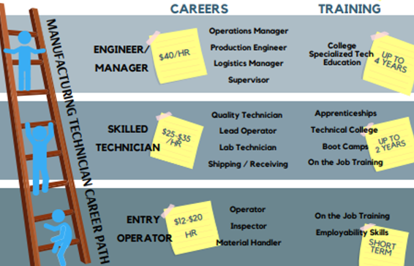
Build a Career in MANUFACTURING -not just a job
Notes:
HOW? You do not need a 4-year college degree all of the time, but you do need training in the right fields.
AT YOUR COMPANY,
What is $/Hour for entry level position? What is an entry level position?
What is $/Hour for a top position? What kind of training do you need to get in that position?
How long will it take to “climb the ladder”?
TIP: Students don’t often realize that they don’t just walk in and get the job if they want it. Talk about how to get an interview?, how long is the interview process? Drug test, etc.

Slide 3
$$$. Does it matter?
$17/hour vs. $29/hour
Hobbies? Kids? Family? Vacations? Retirement?
Notes:
When you put in hard work and show a desire to learn and are motivated to continuously improve, your job can become a career which affords you a life you work for. Tell them that using these
EMPLOYABILITY SKILLS (examples): Pick one and talk about how it has helped you in your career either at the beginning or now. Ask them how they can apply that skill now while they are in school.
Continuous Improvement (time management)
Desire to Learn (minimize phone use)
Curiosity (look for opportunities)
Motivation (attendance)
TIP: if students ask how much $ you make, first assume that they have the best intentions and are curious. Second, you may redirect by saying how many or types of vacations you went on when you started your career vs. types of vacations you go at this point in your career.

Slide 4
ACTIVITY
Notes:
PICK 1 ACTIVITY: It is important to engage the kids in an activity to relate to your presentation. Here are some ideas – pick one.
Color Matching (10 minutes)
Materials: 2 colors of playdough; Prep: Take a small amount of each color of playdough and mix until get a consistent color throughout.
Divide into teams. Give each team 2 colors of playdough and tell them to mix them until they match the color you got on your sample piece.
Set a timer and when it goes off, whichever team has the closest to the sample color wins.
Talk about customer requirements, specifications, waste elimination, etc.
Timed Lego Building (10 minutes)
Materials: legos or colored blocks, a picture of how the legos/blocks look once built to specification
Divide into teams. Give each team the same # and type of legos/blocks and a picture of how it will look (face down).
Tell them they have to build the structure as pictured and the team that finishes first, wins.
MOCK INTERVIEW (10 minutes) Ask for volunteers. Interview student in front of whole class. Get the audience of students to snap when they like an answer. Suggest keep it to 5 questions or less. High School Interview Questions (With Sample Answers) | Indeed.com
GOLD BALL PRODUCTION (10 minutes)
Materials: golf balls
Break into teams of 10+/-. Each student represents a process (Manager, Receiving, Operator 1, Operator 2, Shipping, etc.)​. The golf balls are your products​. The process is tossing the balls one by one from beginning to end (everyone must touch the product). Determine the process order (who is 1, 2 3 etc​). Delivers one order (one ball), process by handling/delivering the order to the next, next, ,next. The last operation then delivers to Shipping, who “packs the order”.​ Run production. Time it. How can you make it faster? Run it again. Time it. Winner.
VIDEO: Show your company video. Or if you don’t have one, use this one: https://www.youtube.com/watch?v=fJ0jTSv4ZWw or choose one from Career videos | Videos | CareerOneStop. Talk about how your company may relate. Ask them a question and wait for an answer OR Ask them for words that describe manufacturing or the jobs they have just seen.
MAKE UP YOUR OWN ACTIVITY…just make sure it isn’t too complicated, involved all students, takes 10 minutes +/-, and an element of competition is good. Make sure you have the materials.
WINNERS: if you give a prize to the winner or the whole class, great! No peanuts or balloons please. Company swag is great too but not necessary.

Slide 5
Insert company LOGO
Insert School LOGO
Notes:
Can they work their while in high school? Do they have to go to college to work there? Are you hiring now?
If you hire work-based learning (WBL) Students, now’s the time to tell the how.
How do they apply? $/hours/benefits as a WBL, Can they still work there after graduation? $/hours/benefits post graduation.
INSERT HIGH SCHOOL LOGO
INSERT COMPANY LOGO
Q&A Ask them what did you learn today? Do you have any questions? If you brought any company swag, give it out now OR give to those that asked questions/participated.
TIP #1: Use everyday terms. Avoid using acronyms.
TIP #2: This can be a career development opportunity for a “junior” employee. You can present and/or send a “junior” employee that kids can relate to.

